Slide 1
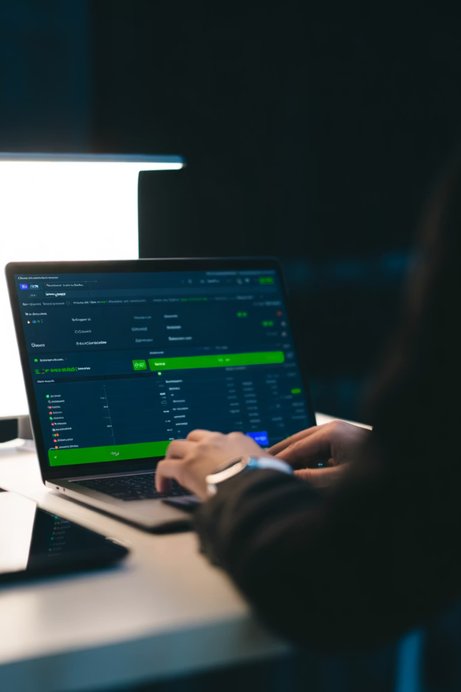
EEL2 PROJECT · SEM-II, A.Y. 2025-26
FinPilot — Financial Management Web Application
A Figma-designed personal finance tool for budgeting, expense tracking, and goal setting.
Group: Aadya Lomte (B25IT1165) · Shubham Pohakar (B25IT1180) · Raunak Meshram (B25IT1182) · Rohit Pravin Kadam (B25IT1184)
Guide: Mrs. Nishanthi Naidu | Dept: Engineering Science & Humanities, MMCOE, Pune

Slide 2

INTRODUCTION
The Problem with Personal Finance
📋 No Clear System
Most people lack a structured way to record and review finances, leading to overspending.
📊 Invisible Spending
Without visual summaries, users cannot identify where their money goes each month.
🎯 Unmotivated Saving
Abstract goals without progress tracking fail to motivate consistent saving behavior.
📱 83% Use Digital Tools
A consumer survey shows strong demand for financial apps — yet many existing tools are too complex.

Slide 3

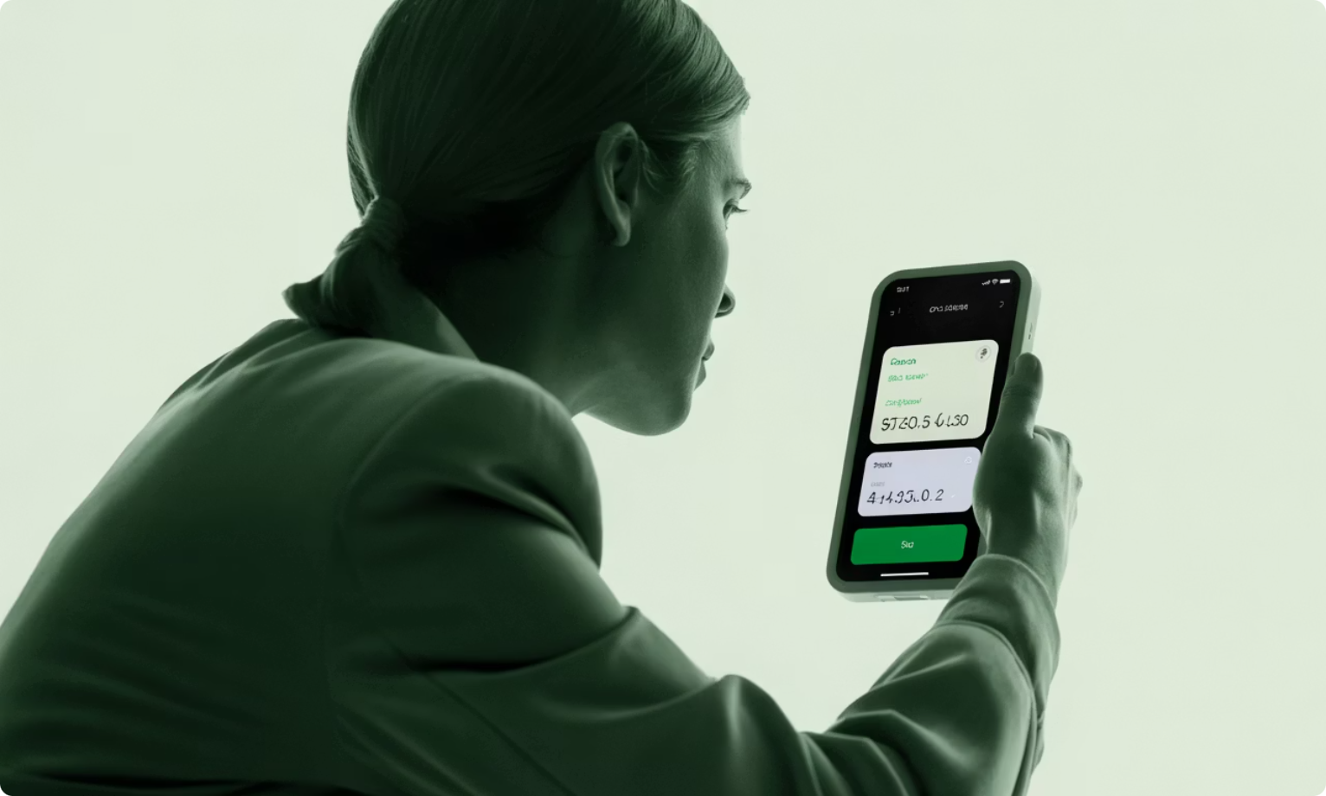
OBJECTIVES
What FinPilot Sets Out to Do
Track Income & Expenses
Easy entry with categories, dates, and payment methods.
Set & Monitor Budgets
Monthly limits per category with overspending alerts.
Savings Goal Tracking
Progress bars and milestones to keep users motivated.
Clear Visual Dashboard
Charts, balances, and trends at a glance — no clutter.
Intuitive UI for Everyone
Designed for non-technical users with a clean Figma prototype.

Slide 4
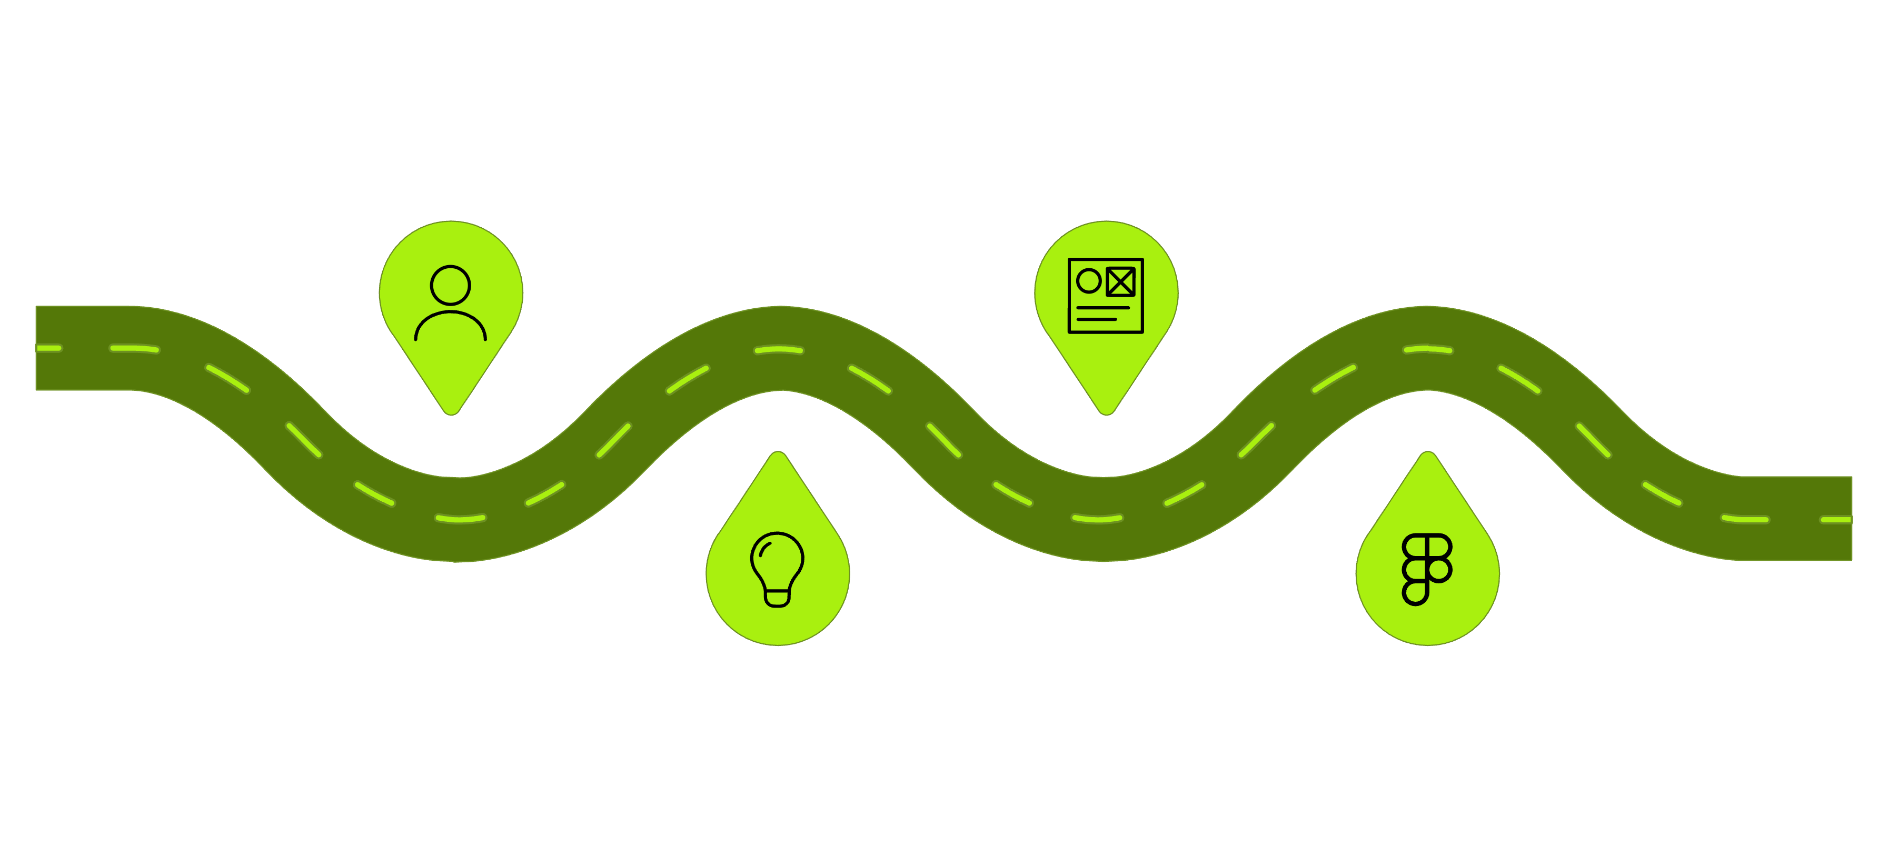
DESIGN PROCESS
From Idea to Interface
User Research
Wireframing
Survey 25 and 5 interviews
Rough layouts and task flows
Brainstorming
High-Fidelity UI
List features and prioritize
Figma screens and prototype
Our team surveyed 25 respondents and interviewed 5 stakeholders (student, professional, homemaker, business owner, retiree). Key insight: users want to log expenses in under 10 seconds and prefer charts over tables. This shaped every design decision.

Slide 5
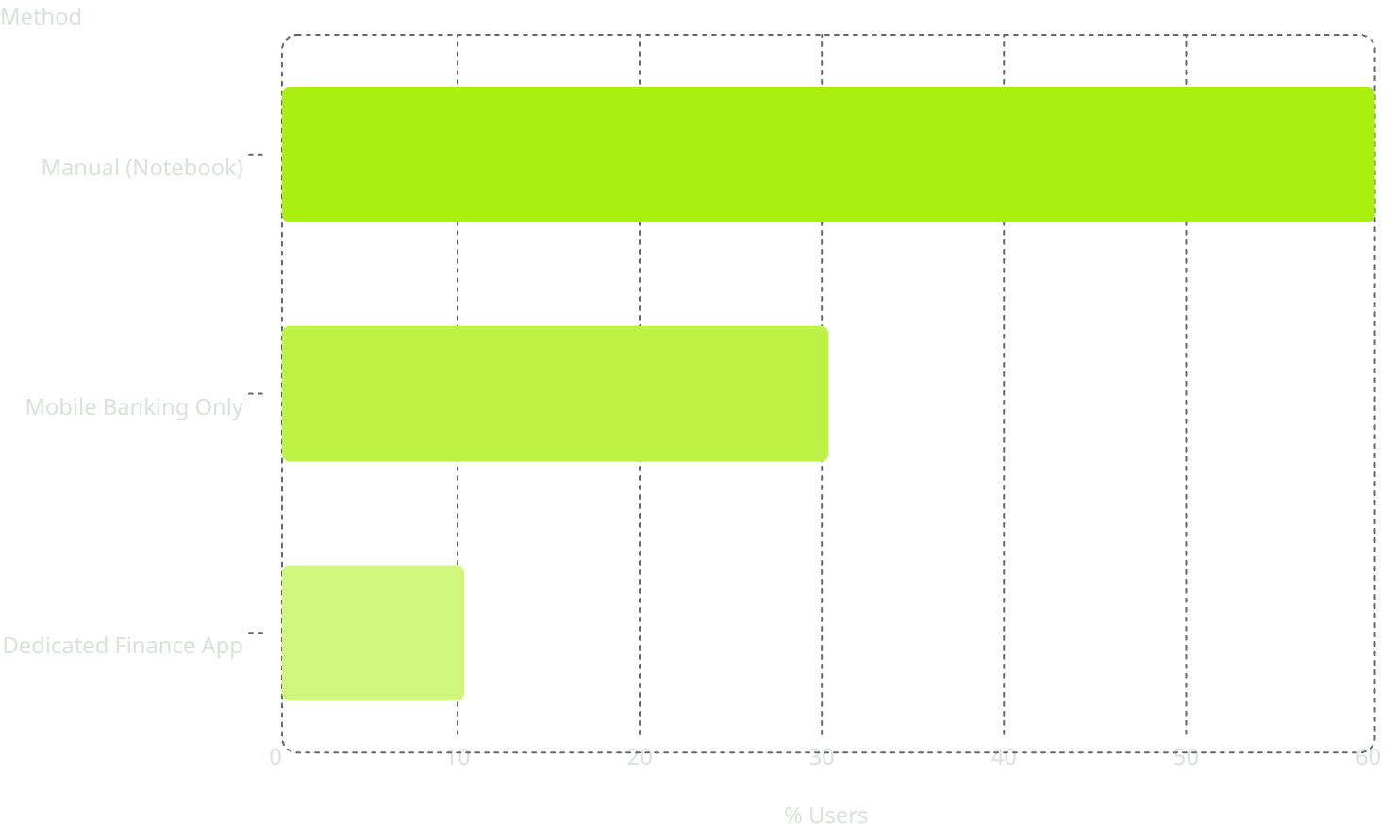
USER RESEARCH
Understanding Our Users
Three Core Personas
Survey Findings (25 Responses)
🎓 Rahul, 20 — Student
Needs quick daily expense logging for hostel budget.
💼 Priya, 28 — IT Professional
Wants budget control across UPI, cards, and savings goals.
🏠 Sunita, 45 — Homemaker
Needs category-wise breakdowns for household planning.
60% relied on manual methods — confirming the need for a simple, dedicated tool.

Slide 6
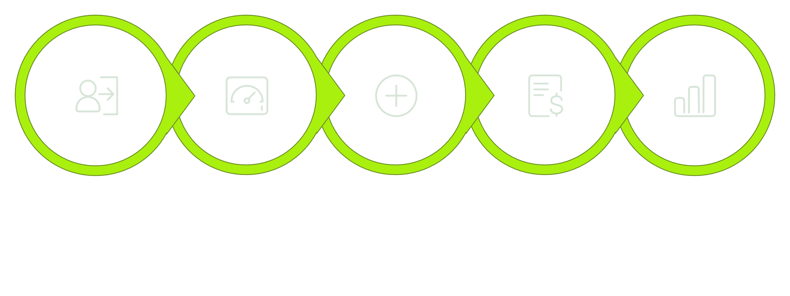
INFORMATION ARCHITECTURE
User Flow & Navigation
Dashboard
Add Entry
Set Budget
Analytics
Login
The app uses a bottom navigation bar with 5 modules: Home, Expenses, Goals, Analytics, and Profile. Every screen is reachable within 2 taps from the dashboard, ensuring fast, intuitive navigation for all user types.

Slide 7
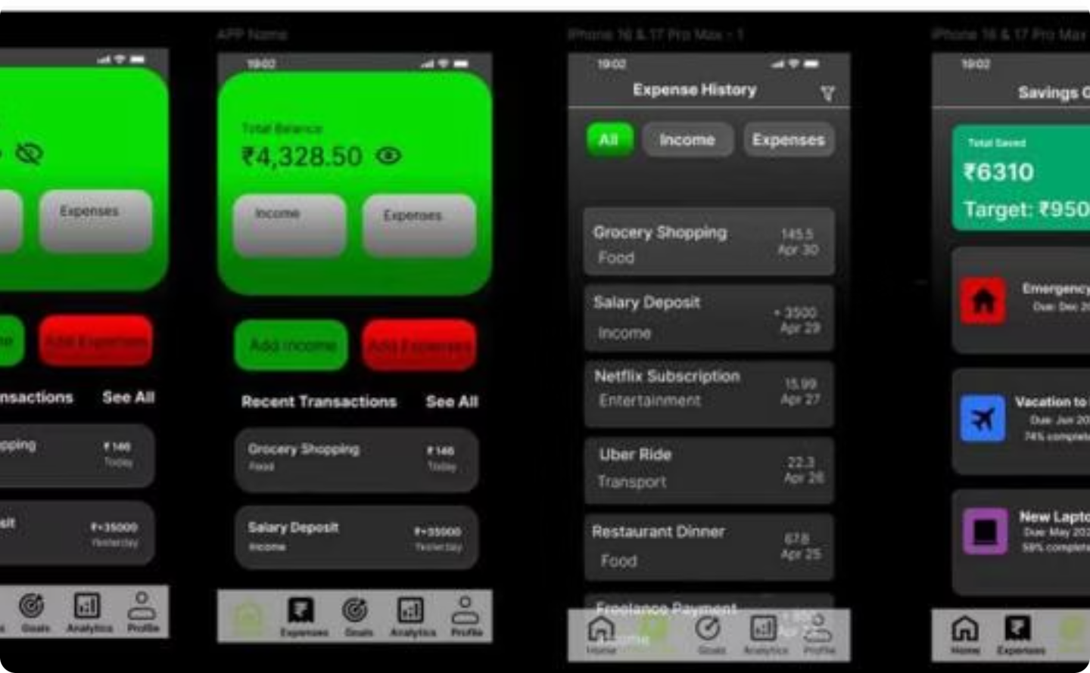
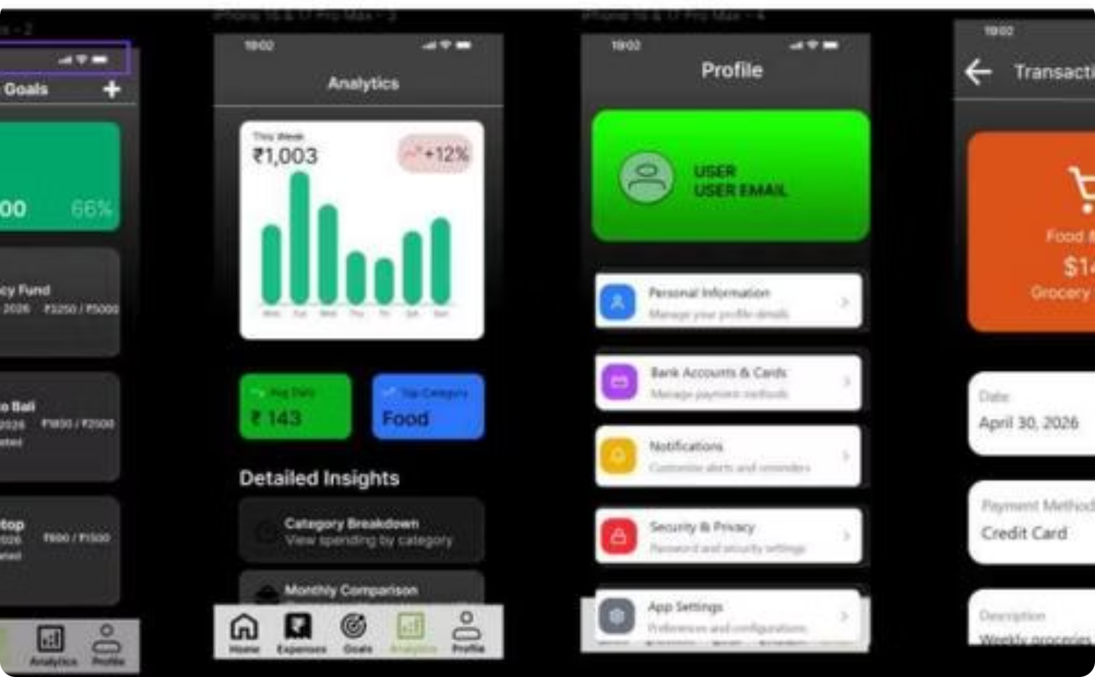
UI SCREENS
Authentication & Dashboard
Dashboard Screen
Goals & Analytics
Shows total balance, quick-action buttons for income/expenses, recent transactions, and savings goal progress. Balance can be hidden for privacy.
Lists savings goals with progress bars and deadlines. Analytics shows weekly spending charts, top categories, and average daily spend.

Slide 8
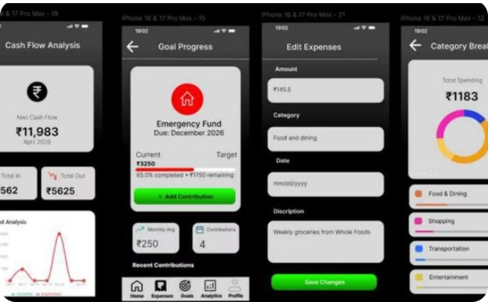
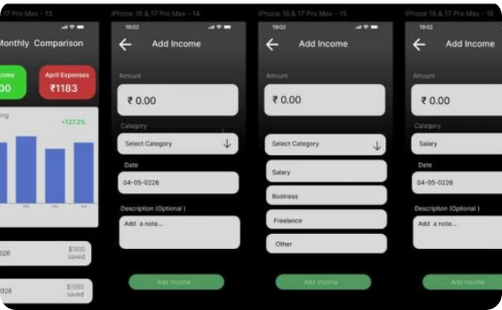
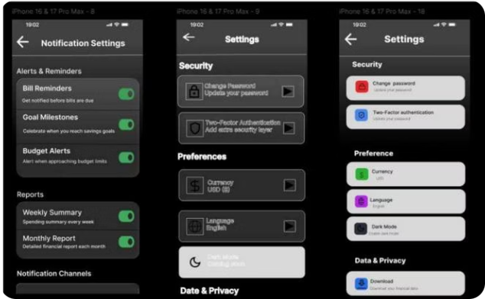
UI SCREENS
Transactions, Settings & Analytics
Cash Flow & Breakdown
Monthly Comparison
Settings & Notifications
Net cash flow with trend charts and a donut chart showing spending by category with percentage labels.
Bar chart comparing income vs. expenses across months, highlighting net savings and seasonal trends.
Toggle controls for bill reminders, budget alerts, and goal milestones. Security, preferences, and data privacy options included.

Slide 9
DESIGN SYSTEM
Style Guide & Visual Identity
Color Palette
UI Component Principles
Typography
Rounded Cards
Progress Bars
Inter typeface — 24pt titles, 14pt body, 12pt captions. Buttons minimum 48pt for easy tapping.
Gradient fills with percentage labels for goal tracking.
Consistent corner radius across all screens for visual harmony.
Dark Theme
Consistent Icons
Reduces eye strain; green symbolizes money and growth.
Uniform icon set; active nav icons use primary green.
Background
Primary
Expense Red
Text
#1C1C1E — Dark charcoal
#34C759 — Green accent
#FF3B30 — Warnings
#FFFFFF / #8E8E93

Slide 10

RESULTS & CONCLUSION
Final Outcome & Future Scope
What We Delivered
Future Scope
25+ unique screens connected by 50+ interaction links in Figma
Complete clickable prototype: login → dashboard → transactions → goals → analytics
Usability tested with 5 participants — 100% success on login and goals tasks
Dark theme with green accents for a modern, trustworthy identity
01
Bank API Integration
Auto-import transactions via UPI and bank connections.
02
Design objectives met: budgeting, expense tracking, goal setting, and intuitive UI — all validated through user testing.
Mobile App (React Native / Flutter)
Native iOS and Android builds from Figma designs.
03
AI Spending Insights
ML-based predictions and personalized budget suggestions.
04
OCR Receipt Scanning
Auto-extract transaction details to reduce manual entry.

